Slide 1

Logistic Regression for Breast Cancer Classification
A report on implementing a Logistic Regression algorithm to classify breast cancer tumors as either malignant or benign based on features from digitized images of fine needle aspirates. The dataset contains 30 features computed from cell nuclei characteristics. The primary objective is to develop a robust binary classification model that can accurately predict the diagnosis of breast cancer.

Slide 2
Introduction to Breast Cancer Classification
Problem Background
AI Solution
Breast cancer is a common cancer affecting women worldwide, and early detection is pivotal in improving treatment outcomes. Traditional diagnostic methods rely heavily on manual examination of tissue samples, which can be time-consuming and subjective.
AI and machine learning have transformed medical diagnostics by enabling predictive models that can analyze complex datasets and identify patterns indicative of disease. Logistic Regression is well-suited for binary classification tasks like tumor diagnosis.
The project aims to provide a deeper understanding of the algorithm's inner workings, including the sigmoid function, cost computation, and gradient descent optimization.

Slide 3

Project Objectives
1
Algorithm Understanding
2
Data Preprocessing
Clean and preprocess the dataset, including handling missing values and standardizing features to prepare the data for model training.
Gain a thorough understanding of the mathematical foundations of Logistic Regression, including the sigmoid function and gradient descent optimization.
3
Model Implementation
Implement the Logistic Regression algorithm from scratch, including functions for computing the sigmoid, cost, and gradients.
The project serves as a comprehensive learning exercise to understand the Logistic Regression algorithm and its application in a real-world scenario. It also lays the groundwork for exploring more advanced machine learning techniques in the future.

Slide 4

Literature Review: AI in Breast Cancer Diagnosis
Early AI Models
Supervised Learning
Early models included decision trees and linear discriminant analysis. Logistic Regression emerged due to its ability to deliver probabilistic outputs, critical for estimating malignancy likelihood.
Supervised learning techniques such as Support Vector Machines and Neural Networks have been used for tumor classification, offering trade-offs in accuracy and interpretability.
Interpretability vs. Accuracy
Balancing accuracy with interpretability is a fundamental challenge. Logistic Regression remains a gold standard due to its clear feature importance and computational efficiency.

Slide 5
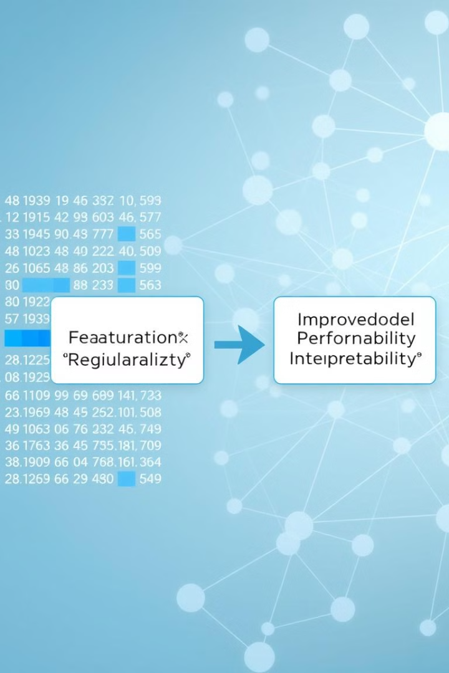


Enhancements to Logistic Regression
Regularized Logistic Regression
L1 (Lasso) facilitates feature selection. L2 (Ridge) mitigates overfitting. Elastic Net combines L1 and L2 for a versatile enhancement.
Feature Selection
Recursive Feature Elimination iteratively removes insignificant features. Principal Component Analysis reduces dimensionality. Mutual Information Selection prioritizes informative features.
These techniques enable LR to compete with more complex models while maintaining its core advantages, making it a robust option for medical diagnostics.

Slide 6




Gaps in Current AI Applications
Over-reliance on Accuracy
Limited Interpretability
Poor Generalization
Many studies emphasize accuracy over precision and recall, which are vital in medical contexts to minimize false negatives.
Advanced models often lack transparency, impeding their integration into clinical decision-making workflows.
Models trained on standardized datasets frequently fail to perform effectively in real-world clinical settings.
Addressing these gaps is essential to advancing the practical utility of AI in breast cancer detection. The potential of regularized LR models remains underexplored, with insufficient research tailoring these techniques to medical applications.

Slide 7
Methodology: Dataset Overview
Dataset
Key Attributes
The Wisconsin Breast Cancer Diagnostic dataset from the UCI Machine Learning Repository contains 569 samples with 32 features each, computed from digitized images of fine needle aspirates of breast masses.
Target Variable: Diagnosis (M = malignant, B = benign)
Features: 30 real-valued features
Class Distribution: 357 benign (62.7%) and 212 malignant (37.3%) cases
The dataset is well-suited for binary classification tasks, making it ideal for implementing and evaluating Logistic Regression.

Slide 8

Conclusion and Future Work
Key Findings
Logistic Regression offers a compelling balance of performance, interpretability, and efficiency in breast cancer classification.
Future Directions
Further research should focus on addressing the identified gaps and exploring the potential of regularized LR models in medical applications.
This project builds on these insights by implementing Logistic Regression from scratch, evaluating its performance, and comparing it with other machine learning techniques. Through this approach, we aim to deepen the understanding of LR's mechanics and bridge the gap between theoretical advancements and practical AI applications in healthcare.

